Slide 1
SAP BTP Architect Training
Day 3
Anubhav Oberoy
www.AnubhavTrainings.com
Follow excellence with sheer passion

Slide 2


DISCLAIMER
The training content and delivery of this presentation is confidential, and cannot be recorded, or copied and distributed to any third party, without the written consent of Anubhav Trainings

Slide 3
Agenda – Day 3
01
Challenges in BTP application development
04
Create DB module with SQLite
02
What is Cloud Application programming Model?
05
Understanding Aspects and associations
04
06
CAPM and CDS Concept
Working with Service Layer

Slide 4
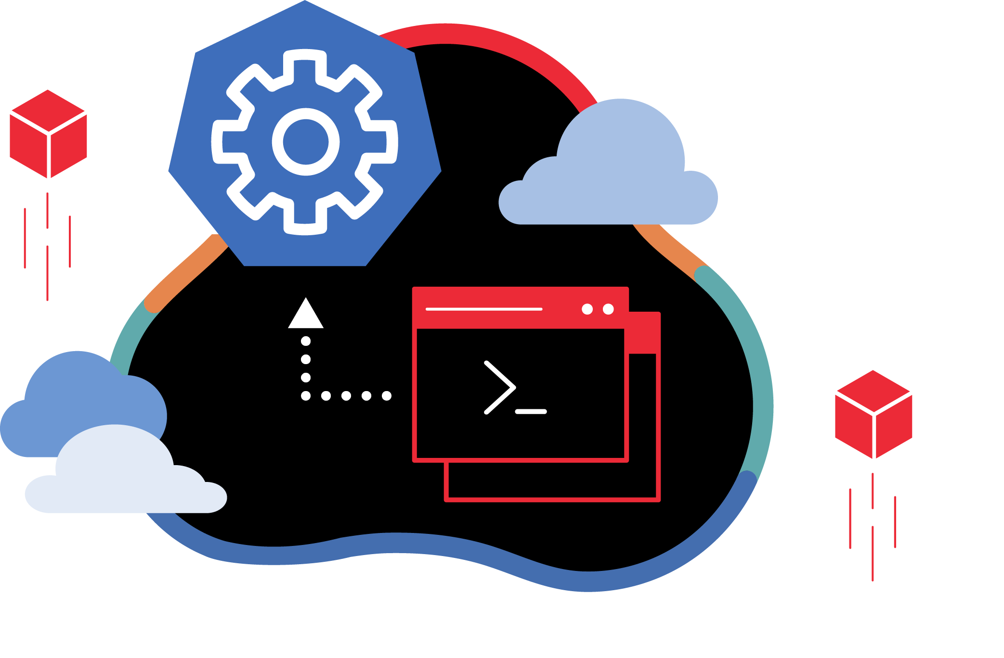
Deploy Node Microservice to BTP

Slide 5
Challenges of building Apps on BTP
What is the best-practice/ gold-standard to build sap btp applications, recommendation by SAP
Are there any existing sample apps which we can follow to build our app
Many times, as a developer it is hard to add each part of app like files, dependencies, deploy descriptor, lots of code. Can this process be simplified?
How can we have reusability of the code to speed up my development and use sap provided tools to generate the skeleton of the apps
As a developer we want to focus more on functional aspect implementation rather initial project setup
Our apps are sometime tightly coupled with DB technology, develop DB agnostic apps
No matter what is the area we belong FIN, SD, MM, PP, PM, APO, CRM, HR etc. eventually as a developer we all do same work. Design tables, write logic, build UI
How to develop software in BTP, which does not require too much time in handovers
SAP CAPM – Cloud Application Programming Model
It’s a SAP provided framework to develop SaaS apps in BTP which is PaaS. If the developer wants to use open source technologies like Node and Java. Great cost saving and freedom of choice of technology and consultants available easily in market.
SAP RAP – Restful Application Programming Model
It is based on ABAP on Cloud. We can build extensions and SaaS application using this framework. The skill required will be ABAP and CDS knowledge. The deployment is very costly as compared to open-source technologies used in CAP.

Slide 6
CAPM Introduction
CAPM is a framework of (a framework is a collection of libraries, classes, function, attributes, events)
Languages – Java and Node JS
Libraries – Node modules like cds, cds-dk etc.
And Tools – VS Code or BAS
The CAP framework is used for building enterprise grade applications & extensions which are cloud-native in SAP BTP.

Slide 7
CDS – Core Data and Services
Conceptually CDS is same concept but different flavor. The concept says that, we have a design time object which is a cds file. We will create a .cds file for almost everything e.g. database tables, views, models, services, UI/UX. This design time object file is compiled by CAPM framework (inside CAP we have node module called @sap/cds) Once the compilation is successful a runtime object gets created.
CREATE TABLE tab(c1 integer, c2 varchar(30), primary key (c1));
---2mn sql statements again
20bn dollars of investment
CREATE TABLE tab COLUMNS c1 integer, c2 varchar, KEY c1;
--20 lakh SQL statements
MySQL
HANA
Too much database coupled

Slide 8
Solution – use CAP framework
entity tab{
c1 number,
c2 string(20)
};
https://cap.cloud.sap/
Design time artefact
.cds
CAPM Framework
SQLite
@sap/cds
CDS Engine
HANA
SQL Code
Database Agnostic

Slide 9
Hands on: Modules for using CAP
We need to install sap cds-dk (Development kit), This kit includes required framework libraries and source code to build, test, deploy, run cap applications. It comes along with cds CLI which will be used by developers to quickly generate the cap project skeleton. This module needs to be installed globally in our system if we are using VS Code, in case we use BAS, this module is pre-installed.
npm install -g @sap/cds-dk
node version >= 14
Check if the CAP is installed in my system ➔ cds –v & cds --help
Create a folder in our computer, and run cds init command. This will create a project skeleton automatically which includes db, srv, ui folders.
If you want to quickly manage multiple node versions in your computer you can use nvm tool - https://github.com/coreybutler/nvm-windows/releases
When we make constant changes to the project, we want project to detect a correction and automatically restart the server. We can use the cds watch command instead of cds run

Slide 10
DB Design
Addresses
1..1
Business partner
(Customers, Suppliers)
1..*
Purchase order
Product Text
(localized)
1..*
1..*
Purchase order Items
1..1
Product

Slide 11

Hands on: Create DB Module
Solution:
https://github.com/soyuztechnologies/SAP_BTP_Training_CLD200/blob/master/Day%203/01%20db.zip

Slide 12
Reuse Types and aspects
When we design database artefacts, at times we have many similar objects and their data types. Instead of hardcoding the type as primitive type, it is recommended to create custom data types. Using custom data type increase reusability and reduce maintenance.
When we create a separate CDS file for reuse purpose and consume it. This file contain types, enumerators and aspects.
Every project would need some common aspects and types related to primary key generation, admin data (created by, created on, changed by, changed on) – temporal, Currency.
Aspect (structures in abap) is combination of many fields.

Slide 13

Hands on: Service creation
Solution
https://github.com/soyuztechnologies/SAP_BTP_Training_CLD200/blob/master/Day%203/02%20srv.zip

Slide 14
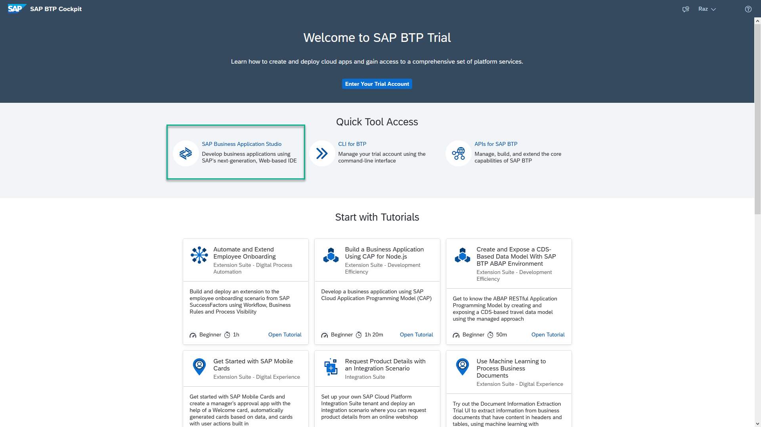
Business Application Studio
SAP Business Application Studio is a development environment available on SAP Business Technology Platform. Before you can start developing using SAP Business Application Studio, administrators must perform the required onboarding steps that are described in this tutorial.
In an Enterprise Account you can set up SAP Business Application Studio as a Free-Tier service by checking its free plan during its entitlement configuration.

Slide 15
Dev Space in BAS
VM
2GB
Dev Space
@cds/dk
VM
2GB
Business Application Studio
PaaS – BTP – Manager of this entire infrastructure
IaaS – AWS – Computer Running on internet
Bunch of servers with hardware – 1000 GB

Slide 16


Hands on: Move App to BAS

Slide 17
Generic Handlers in CAP
The CAPM framework generates most of the code to perform CURDQ operations on the entity. It does not know what validations to perform on our business data. As a developer, when we want to attach a pre-check (validations) / post-check (post processing code) on an entity operation, we can use generic handlers. All these operations are performed SYNCHRONOUSLY.
At times we want to
Take full control of our implementation
We want to add some validation before data is inserted or updated
We want to change data before insert/update
Read some extra information while GET calls
Fiori app
odata
cap
Generic handlers
database
before
on
after

Slide 18

Hands on: Generic Handlers

Slide 19
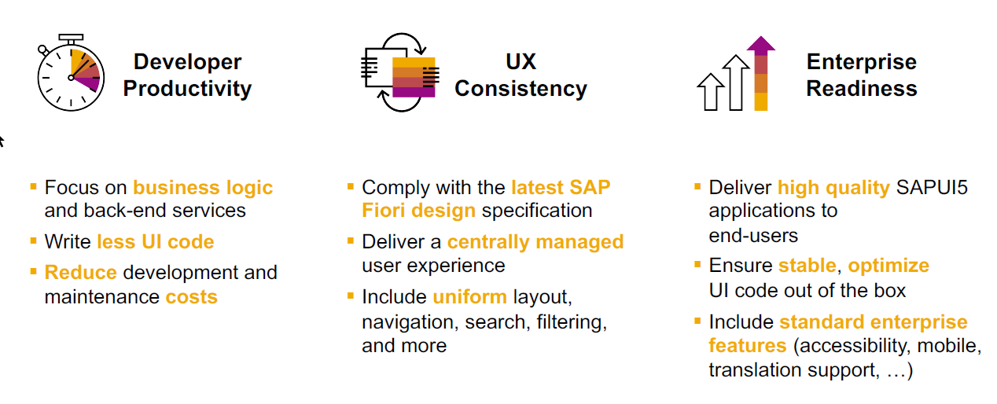
SAP Fiori elements boosts SAP Fiori development efficiency

Slide 20
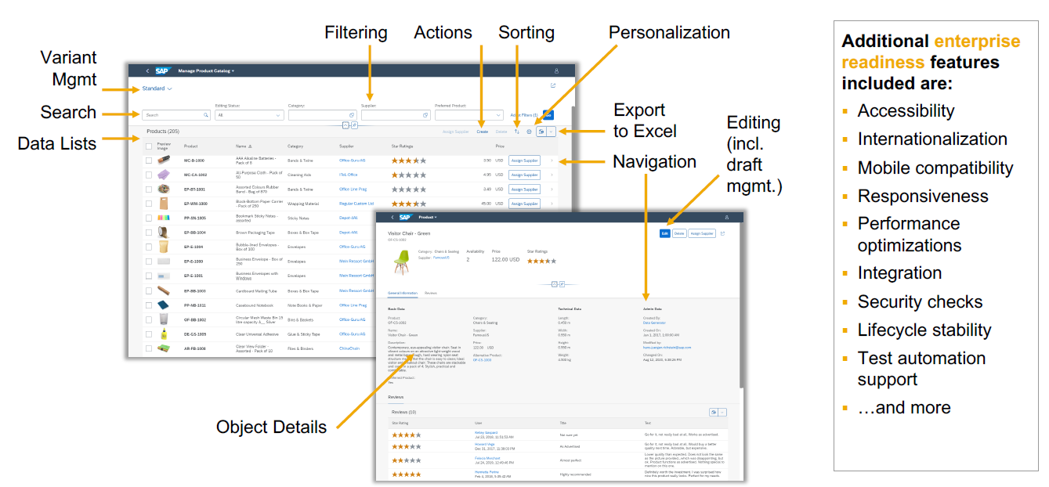
SAP Fiori elements provides enterprise-ready apps out of the box

Slide 21
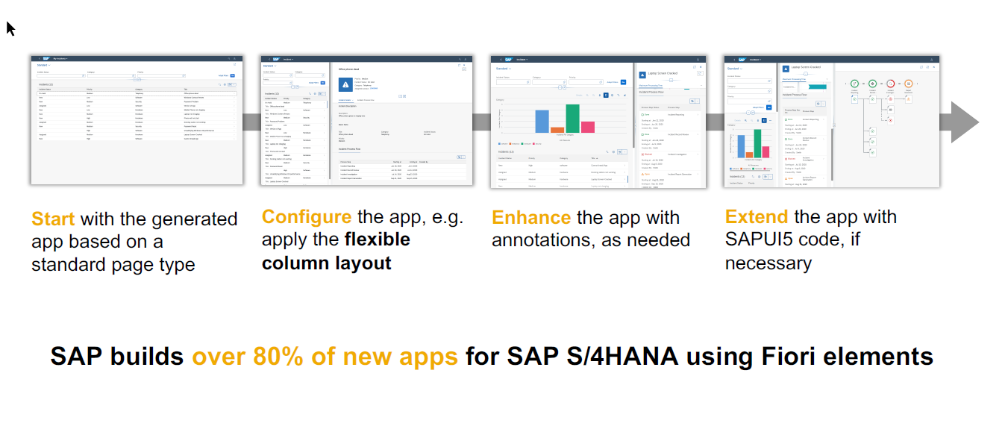
SAP Fiori elements application architecture provides flexibility

Slide 22
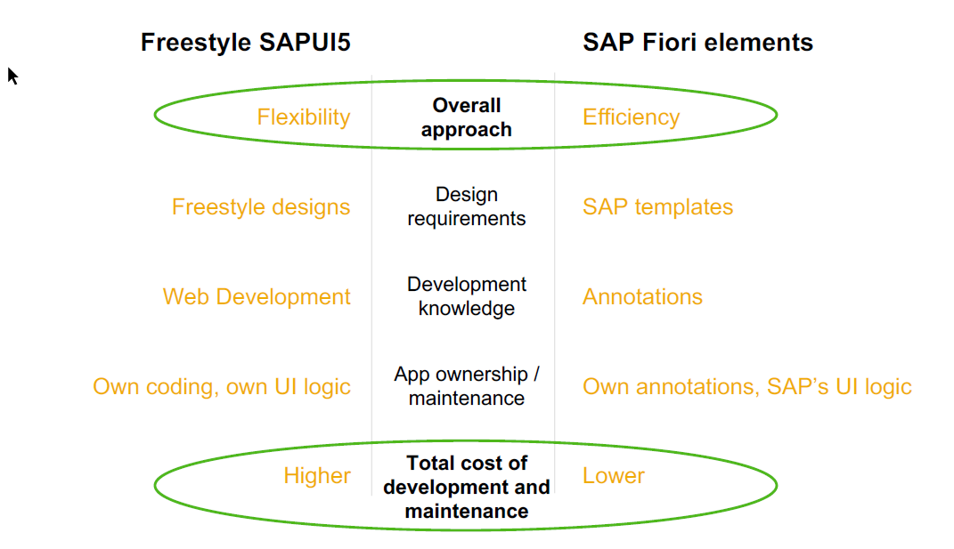
SAP Fiori elements prioritizes efficiency over flexibility

Slide 23
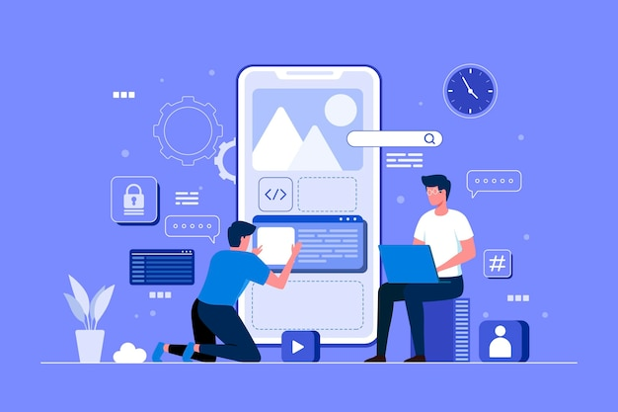
Hands on : Fiori App

Slide 24
Association v.s Composition
Association – a relationship between entities which is a lose coupling. Both objects should exist together. However, they can work independently. Airplane and passenger.
Composition – a relationship between entities which is a tight coupling. Both objects must exist together. They cannot function independently. Airplane and wings.
Purchase Order Header
composition
Purchase order Items

Slide 25

Hands on: Create Enablement for app
Solution
https://github.com/soyuztechnologies/SAP_BTP_Training_CLD200/blob/master/Day%203/03%20application.zip

Slide 26

What We Did
Let’s Summarize

Slide 27

www.anubhavtrainings.com
Thank You
End of Day 3

Slide 28


We’re committed to empower you to be
#FutureReady
through powerful training solutions.
We build the workforce of the future.
250+
Corporate Clients
40,000+
Learners Trained
25000+
Learners Placed
FREE WEBINARS
Sign up for free webinars with industry experts every fortnight!
Enroll Now!
Contact us today!
https://anubhavtrainings.com

Slide 29
Agenda – Day 3
01
Understanding Aspects and associations
04
Generic Service handlers
02
05
Working with Service Layer
Introduction to Fiori Elements
04
06
Business Application Studio
Adding UI module

